Slide 1
Formal Language & Automata Theory
Prof. Sankhadeep Chatterjee

Slide 2
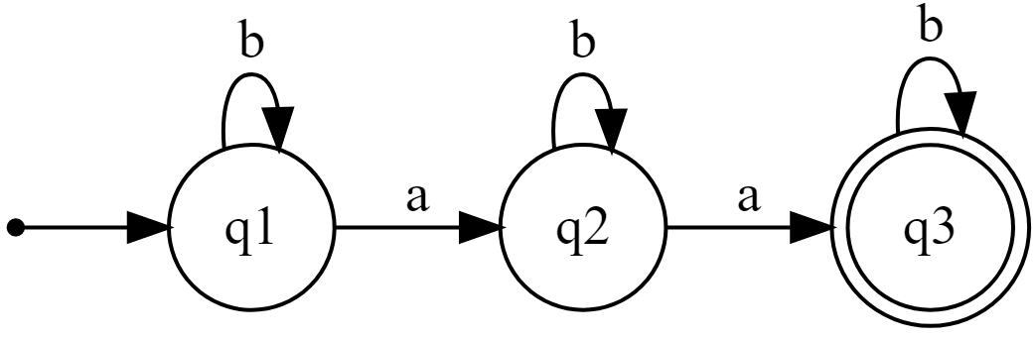

Examples
Design a DFA that accepts the following language:
$L=\left\{w \right| n_{a}\left(w\right)=2\}$ over $Σ=\{a,b\}$

Slide 3
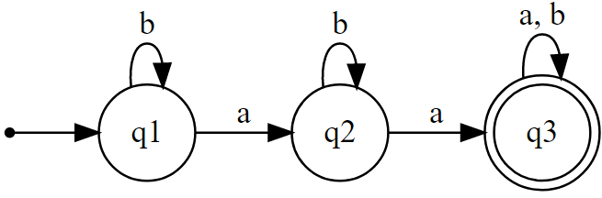

Design a DFA that accepts the following language:
$L=\left\{w \right| n_{a}\left(w\right)≥2\}$ over $Σ=\{a,b\}$

Slide 4
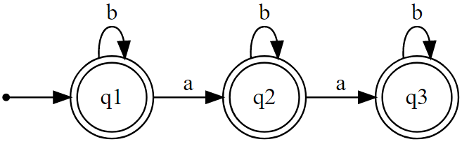

Design a DFA that accepts the following language:
$L=\left\{w \right| n_{a}\left(w\right)≤2\}$ over $Σ=\{a,b\}$

Slide 5
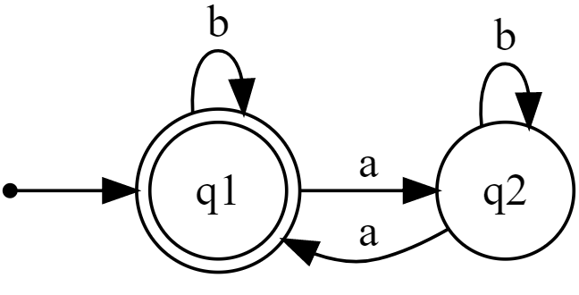

Design a DFA that accepts the following language:
$L=\left\{w \right| n_{a}\left(w\right) divisible by 2\}$ over $Σ=\{a,b\}$

Slide 6
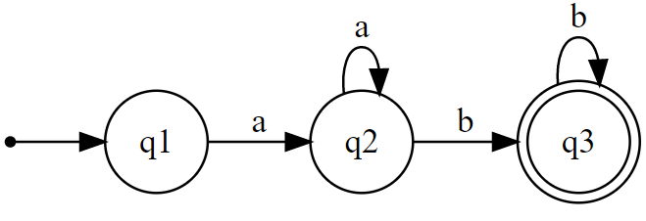

Design a DFA that accepts the following language:
$L=\left\{a^{n}b^{m}\right| m,n>0\}$ over $Σ=\{a,b\}$

Slide 7
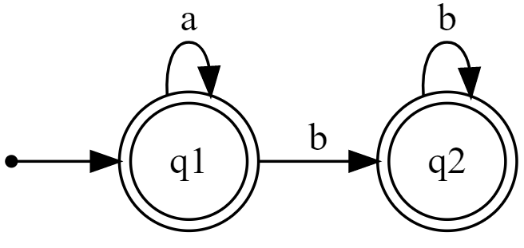

Design a DFA that accepts the following language:
$L=\left\{a^{n}b^{m}\right| m,n≥0\}$ over $Σ=\{a,b\}$

Slide 8
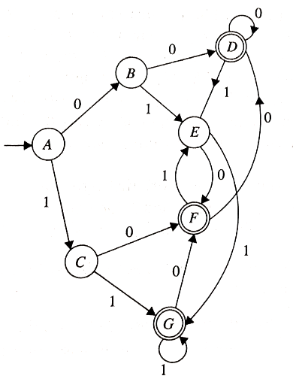
Find the minimized DFA for
the following DFA using Table Filling
Algorithm?

Slide 9
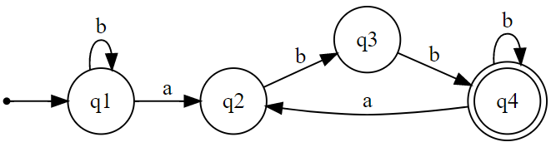

Design a DFA that accepts the following language:
$L=\left\{w\right| Every a is followed by two bs\}$ over $Σ=\{a,b\}$

Slide 10
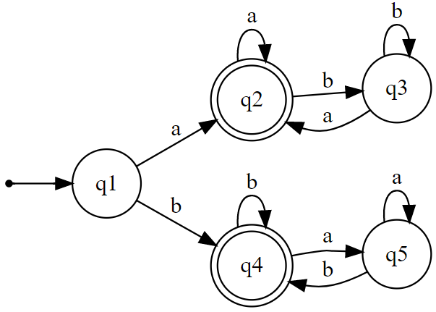

Design a DFA that accepts the following language:
$L=\left\{w\right| w starts and end with same symbol\}$ over $Σ=\{a,b\}$

Slide 11
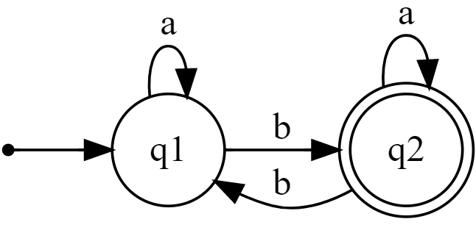

Design a DFA that accepts the following language:
$L=\left\{w\right| w contains odd number of b\}$ over $Σ=\{a,b\}$

Slide 12
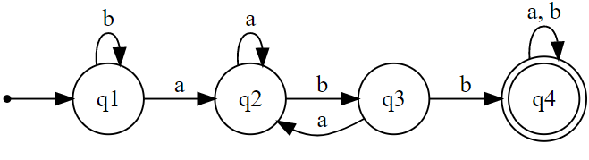

Design a DFA that accepts the following language:
$L=\left\{w\right| w contains substring ′abb′\}$ over $Σ=\{a,b\}$

Slide 13
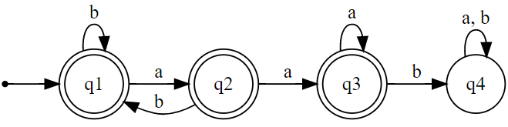

Design a DFA that accepts the following language:
$L=\left\{w\right| w does not contain substring ′aab′\}$ over $Σ=\{a,b\}$

